Slide 1


Department of Justice and Community Safety (DJCS)
Author: SR
DJCS-Version:1.0
Date: Sep 27, 2021

Slide 2
Executive Summary
Department of Justice and Community Safety
Slide1
Overall Statistics & Insights
Slide2
Offence Statistics & Insights
Slide3
Time Intelligence Insights
Step4
Summary

Slide 3
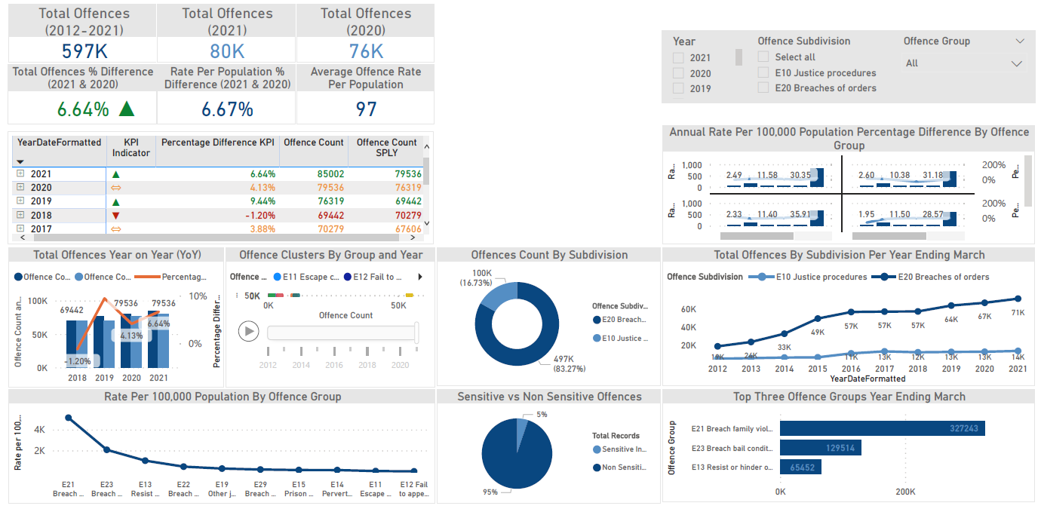
Slide 1: Overall Statistics & Insights
Department of Justice and Community Safety
E Justice Procedures Offences
Notes: Data source Crime Statistics Agency.
In order to maintain confidentiality, sensitive offence counts with a value of 1 to 3 are displayed as "≤ 3" and are given a value of 2 to calculate totals.
Recorded crime statistics are based on data extracted by Victoria police on the 18th day after the reference period, and are subject to movement between releases. Year ending month is March.
*SPLY = Same Period Last Year

Slide 4
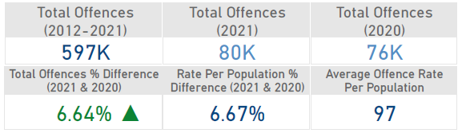
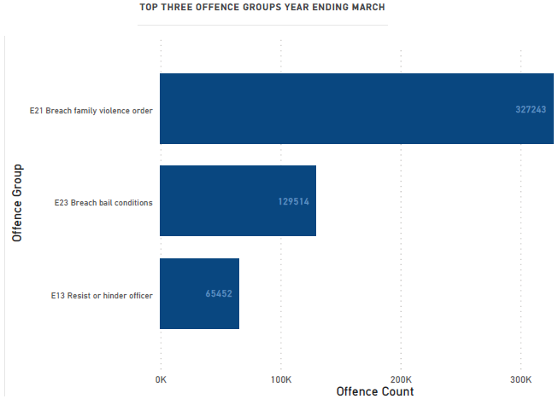
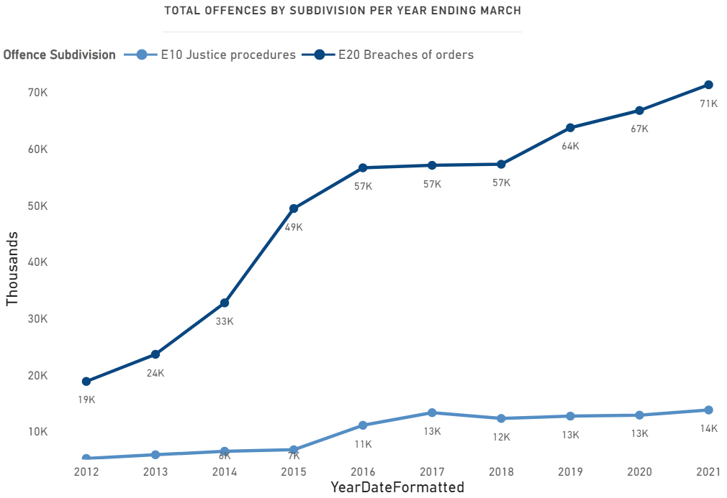
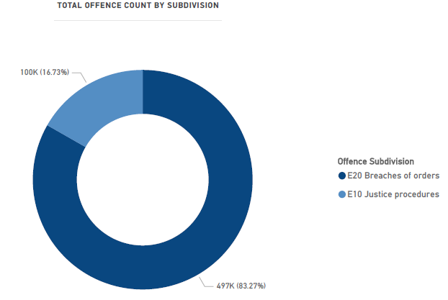
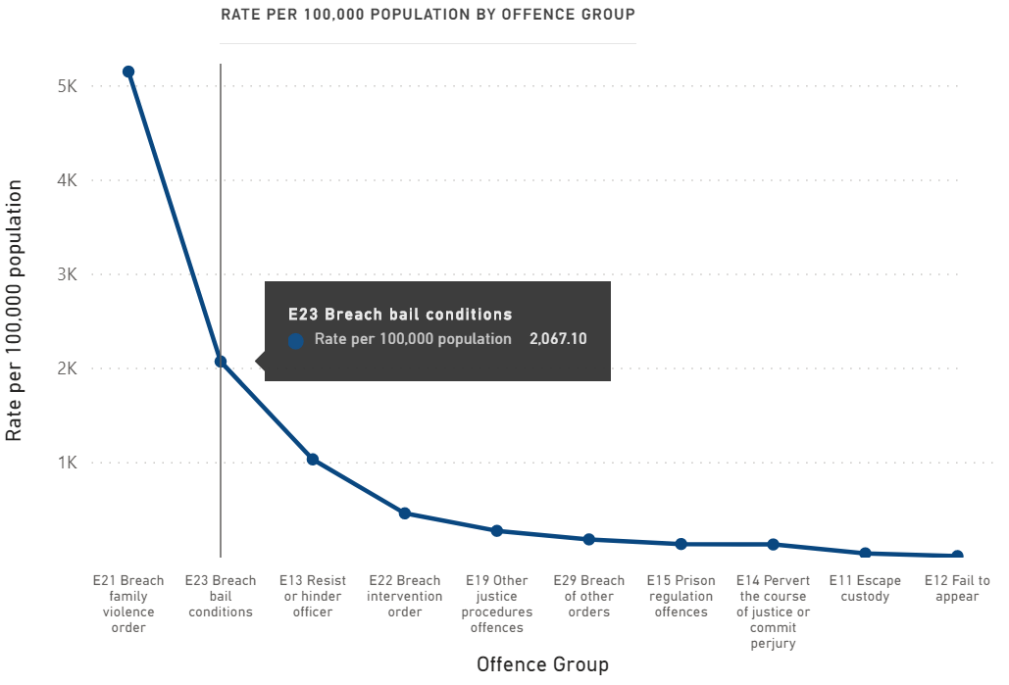
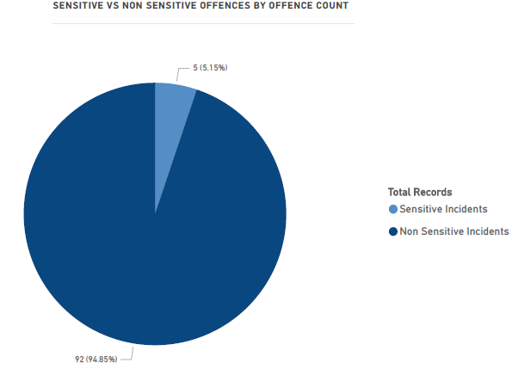
Slide 2: Offence Statistics & Insights
Department of Justice and Community Safety
E Justice Procedures Offences

Slide 5
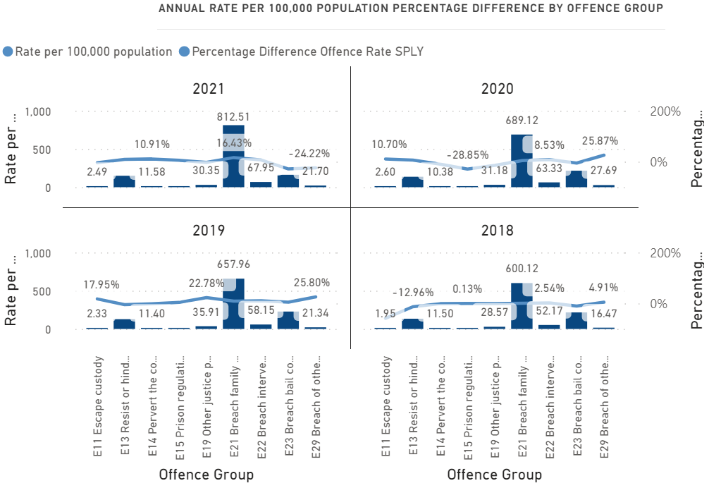
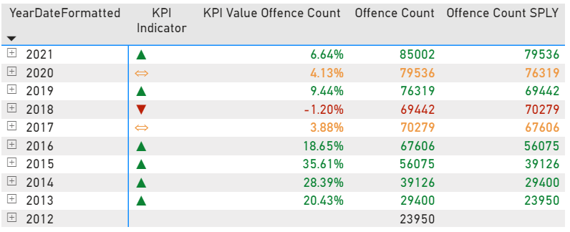
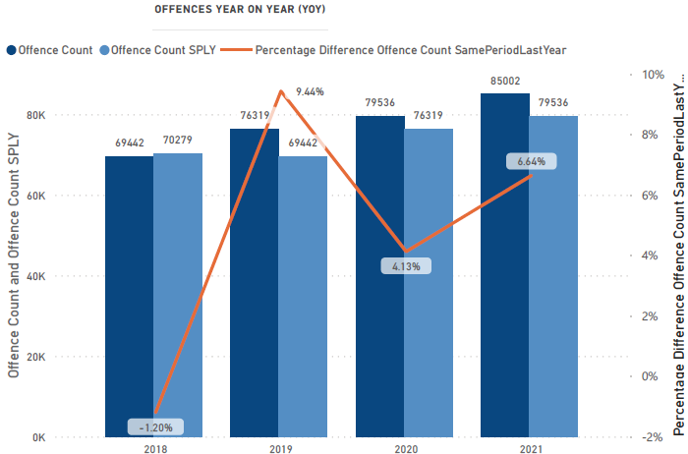
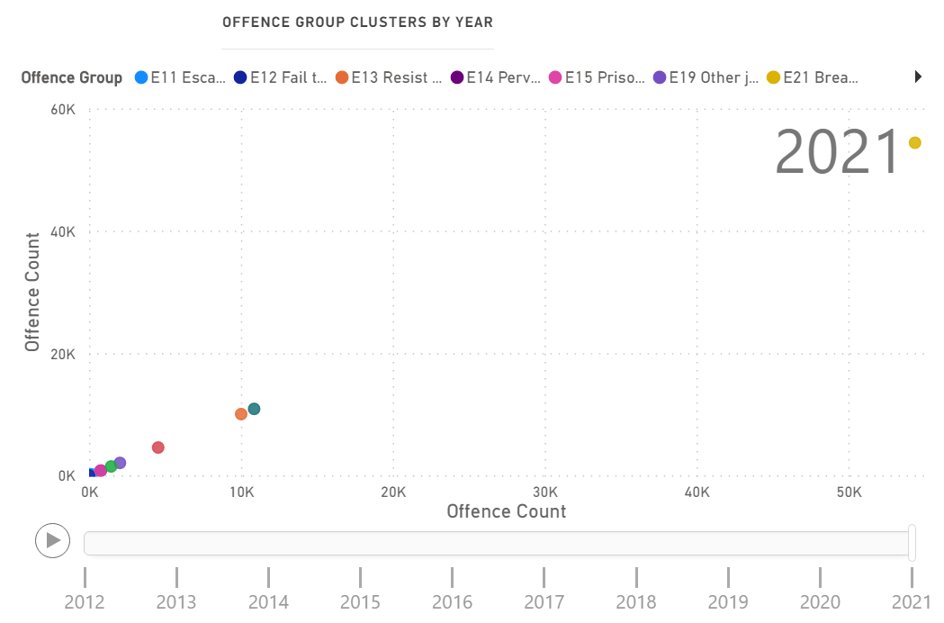
Slide 3: Time Intelligence Insights
Department of Justice and Community Safety
E Justice Procedures Offences
KPI - * More than 5% shows significant increase indicating an upwards trend in green, and more than 1% shows significant decrease indicating a downward trend in red, whereas orange signifies a less than significant threshold.

Slide 6
Slide 4: Summary
Department of Justice and Community Safety
Slide 1: Overall Statistics & Insights
﻿Total Offence Count is 597K for the period of 2012-2021, a little over 85K in 2021, and almost 80K in 2020.
﻿For the year 2021 and 2020, the Total Offence Count difference was increased by more than 5%.
For the year 2021 and 2020, both the Offence Count & Rate Per 100,000 Population Percentage difference at above 6% (increase).
Overall average Offence Rate Per 100,000 Population is 97
E21 Breach Family Violence Order is the highest trending offence, whereas E12 Fail to Appear is the lowest trending offence, followed by E11 Escape Custody.
Slide2: Offence Statistics & Insights
﻿At 85002, 2021 had the highest Offence Count at 22.41% higher than 2018, which had the lowest Offence Count at 69442.
﻿Total Offence Count E20 Breaches of orders (496881) at 83% which is higher than E10 Justice procedures (99854) at almost 17%.
﻿﻿Top 3 Offences Count consists of E21 Breach family violence order had 327243,followed by E23 Breach bail conditions had most offences at 129514 and E13 Resist or hinder officer had 65452.
*Interesting Data Science Fact: ﻿﻿ ﻿﻿Current Year Offence Count and Total Offence Count for the Same Period Last Year (SPLY) are positively correlated with each other, i.e moving in the same direction.
Slide3: Time Intelligence Insights
In 2021, E21 Breach Family Violence Order cluster exceeded 50K, compared to the year 2014 at under 20K.
Offences Year on Year (YoY) Percentage Difference for the Same Period Last Year (SPLY) shows an decrease in offences at -1.20% between the year 2017 and 2018, and an increase at 6.64% for the year 2020 and 2021.
In 2021, E21 Breach Family Violence Order group is showing the highest Offence Rate Per Population at 812.51 showing a percentage difference for the Same Period Last Year (SPLY), an increase at 16% , whereas the lowest is at 2.49, a decrease at -4% for E11 Escape Custody group.
Notes:
Research Links: http://dvvic.org.au/impact/in-the-news/
https://www.crimestatistics.vic.gov.au/crime-statistics
https://oag.ca.gov/sites/all/files/agweb/pdfs/cjsc/stats/computational_formulas.pdf

